Slide 1




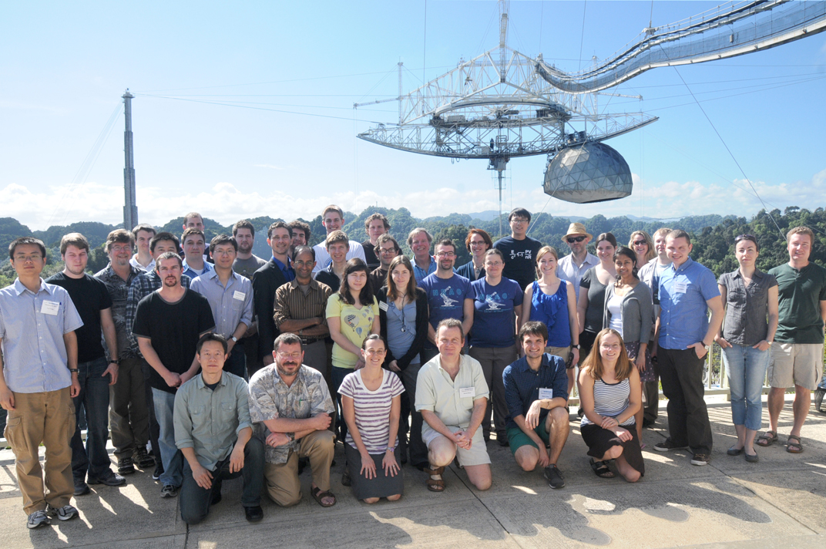
Maura McLaughlin
West Virginia University
IPTA Science Meeting 25 June 2012

Slide 2
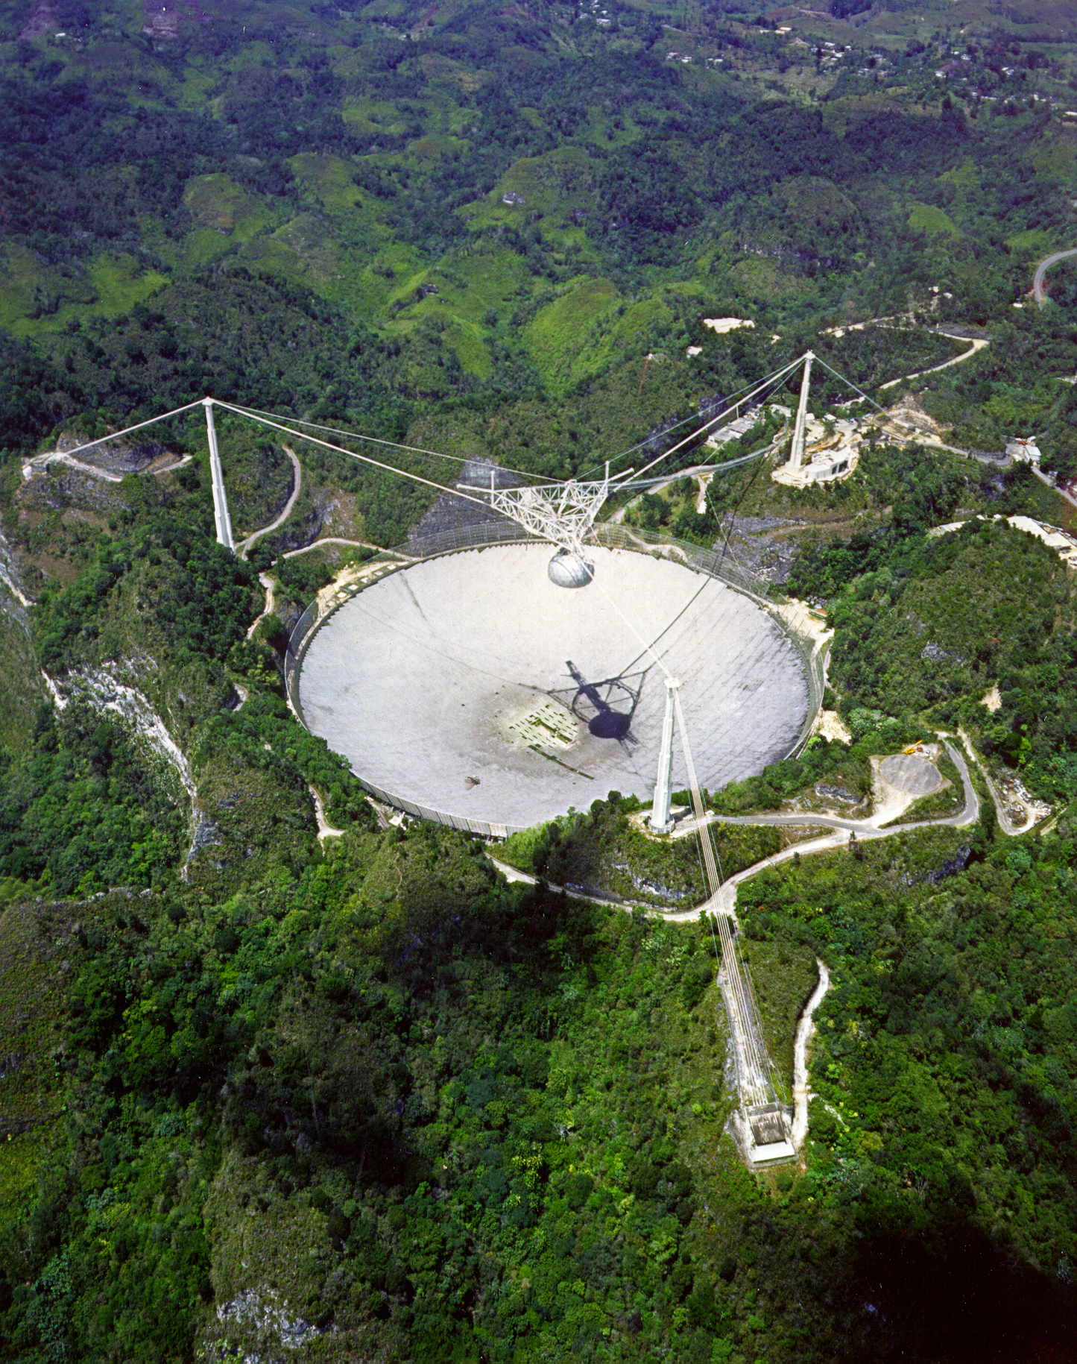
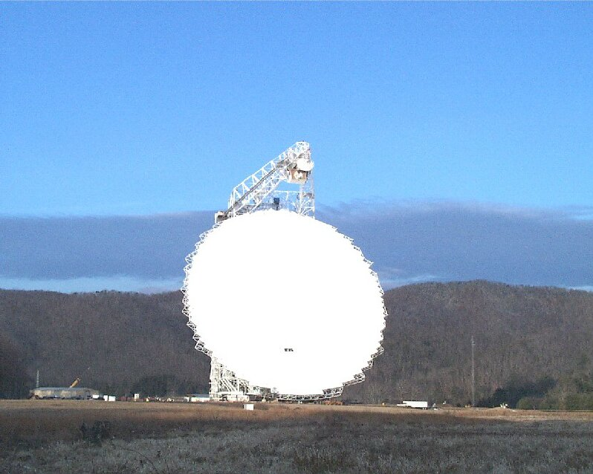
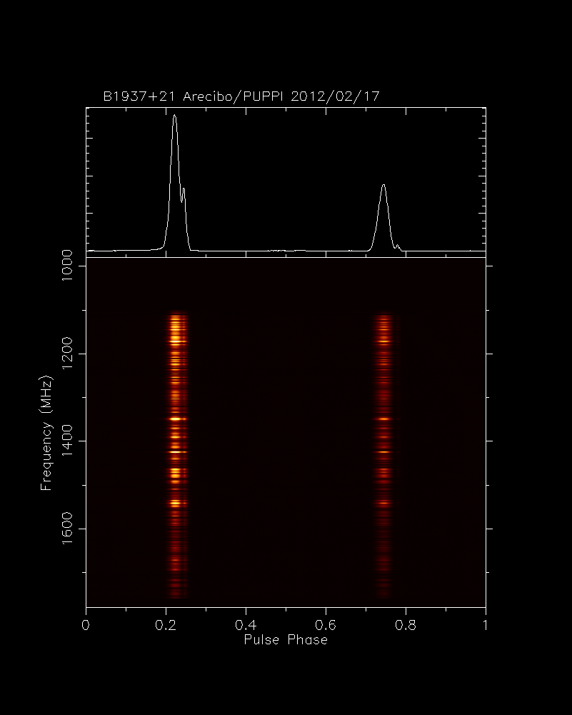
Outline
Who are we?
Policies and Organization
Science
International Education
Outreach
Summary and the Future
IPTA Science Meeting 25 June 2012
Notes:
IMPT that we understand how the individual PTAs work as I think it will inform how the IPTA will work.

Slide 3
Who are we?
A consortium of researchers using North American telescopes for pulsar timing for GW detection. Formed in 2007.
Anyone who shares this goal is welcome to apply for membership!
DRAFT membership policy defines Junior, Associate, Full, and Legacy Members.
http://nanograv.org
IPTA Science Meeting 25 June 2012
Notes:
Ramifications of levels – voting and authorship.

Slide 4
Who are we?
Current members include 15 SP, 2 computing staff, 10 postdocs, 10 graduate students, and 8 undergrads.
Australia Telescope National Facility – Ryan Shannon
Cornell University – Jim Cordes, Adam Brazier, Shami Chatterjee, Dusty Madison
Franklin & Marshall College – Andrea Lommen, Brian Christy, Ryan Anella, Emma Handzo, Joe Simon
Goddard Space Flight Center – Zaven Arzoumanian
Lafayette College – David Nice, Anthony Post, Joey Tumulty
McGill University – Vicky Kaspi,
Oberlin College – Dan Stinebring, Tim Dolch, Sam Berney, Greg Stevens
NRAO/UVA – Scott Ransom, Paul Demorest, Tim Pennucci
Jet Propulsion Laboratory – Joe Lazio, Sarah Burke-Spoloar
Penn State University – Sam Finn, Xihao Deng, Michael Koop
University of British Columbia – Ingrid Stairs, Marjorie Gonzalez, Weiwei Zhu
University of Cagliari – Delphine Perrodin
University of Manchester – Rob Ferdman
University of Texas, Brownsville – Rick Jenet, Yan Wang, Jing Lou, Kevin Stovall
University of Wisconsin, Wilwaukee – Xavier Siemens, Justin Ellis, Sydney Chamberlin
West Virginia University – Duncan Lorimer, Maura McLaughlin, Nate Garver-Daniels,, Nipuni Palliyaguru, Joe Swiggum, Gary Marchiny
IPTA Science Meeting 25 June 2012
Notes:
45 members. Large but also a broad definition and many students. Apologies NANOGravers and note italic members. Some members at non US and Canadian institutions. OK.

Slide 5

Who are we?
The NRAO and the Arecibo Observatory are institutional members as
of March/April 2012.
IPTA Science Meeting 25 June 2012
Notes:
Put signed MOUs here.

Slide 6
Draft Publication Policy
A NANOGrav paper is one which is related to NANOGrav science, or which uses data collected for the NANOGrav project, or which uses NANOGrav-developed tools, and which has one or more members of
NANOGrav as authors.
NANOGrav upper limit and detection papers will include all Full Members and have alphabetical authorship.
Other papers will be authored by all who contributed significantly, with author order determined by the authors.
IPTA Science Meeting 25 June 2012
Notes:
WHY is this favored? The feeling is that lots of people contribute to these papers and this ensure everyone receives credit. We believe it will foster collaboration and also give more credence to these papers.

Slide 7
Organization
IPTA Science Meeting 25 June 2012
Notes:
Not official. Audrey and me last night.

Slide 8
Organization
Election for Chair will be held every two years.
IPTA Science Meeting 25 June 2012

Slide 9
Organization
Management Team consists of four or five other members.
IPTA Science Meeting 25 June 2012

Slide 10

Organization
Advisory Board consists of six eternal experts.
IPTA Science Meeting 25 June 2012

Slide 11
Organization
Lisa Kohne evaluates our organization, milestones, and meetings.
IPTA Science Meeting 25 June 2012

Slide 12
Science Working Groups
IPTA Science Meeting 25 June 2012

Slide 13
Timing
Instrumentation:
GASP (2004 – 2011) - Mark4 & ABPP (1998 – 2005)
GUPPI (2011 – present) - ASP (2004 – 2012)
- WAPP (2004 – 2012)
- PUPPI (2012 – present)
P. Demorest
IPTA Science Meeting 25 June 2012
Notes:
Older data. Got working during the Arecibo meeting we were at in February.

Slide 14
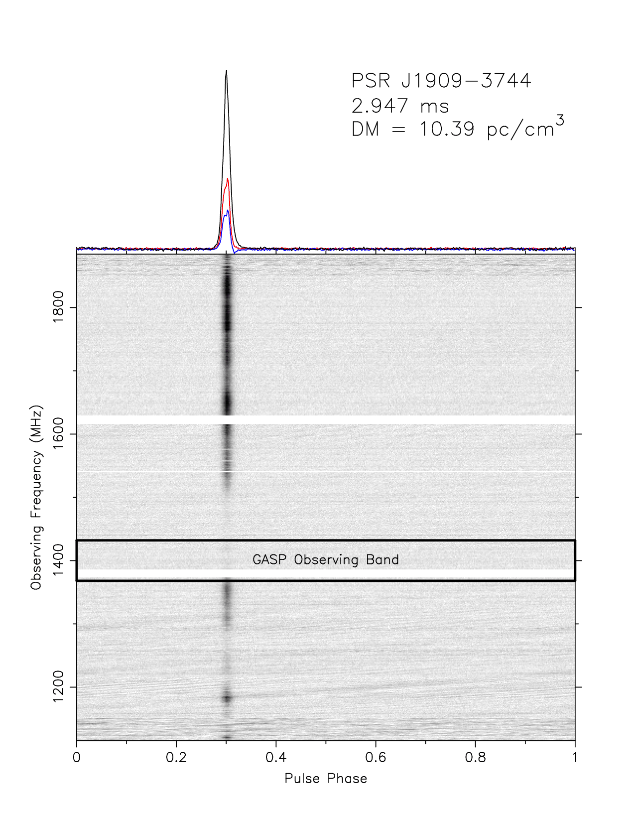
Timing
Instrumentation:
GASP (2004 – 2011) - Mark4 & ABPP (1998 –
GUPPI (2011 – present)
factor of 2-3 improvement
in timing precision!
S. Ransom
IPTA Science Meeting 25 June 2012
Notes:
Two telescopes.

Slide 15
Timing
Current Observations:
Observing 35 pulsars (19 with AO and 18 with GBT)
GBT every 20 days at 800/1400 MHz
AO monthly at two of 327/430/1400/2350 MHz
At 18 hr/epoch on each telescope, total of 540 hours per year (plus more hours for additional pulsars!)
AO
GBT
Observed since 2005
Pulsars added ~2009
Pulsars added ~2011
IPTA Science Meeting 25 June 2012
Notes:
RA coverage. Proposal under review.

Slide 16
Timing
Demorest et al. (2012) on > 5 years of ASP and GASP data for 17 pulsars.
http://www.cv.nrao.edu/~pdemores/nanograv_data/
IPTA Science Meeting 25 June 2012
Notes:
DM parameters – time variable DM changes. Profile parameters -

Slide 17
Timing
Demorest et al. (2012) on > 5 years of ASP and GASP data for 17 pulsars.
J1713+0747
30 ns RMS
J1012+5307
280 ns RMS
J1643-1224
1.5 μs RMS
IPTA Science Meeting 25 June 2012

Slide 18
Timing
Demorest et al. (2012) on > 5 years of ASP and GASP data for 17 pulsars.
Single-pulsar limit of
h_{c} < 1.1 x 10⁻¹⁴ (f=1 yr⁻¹)
Hellings and Downs limit h_{c} < 7 x 10⁻¹⁵ (f=1 yr⁻¹)
See Paul’s talks for details of analysis and astrophysical implications.
IPTA Science Meeting 25 June 2012
Notes:
SINGLE PULSAR LIMIT.

Slide 19
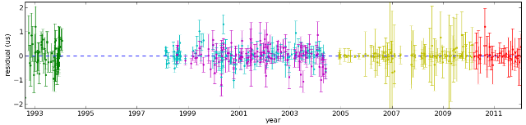
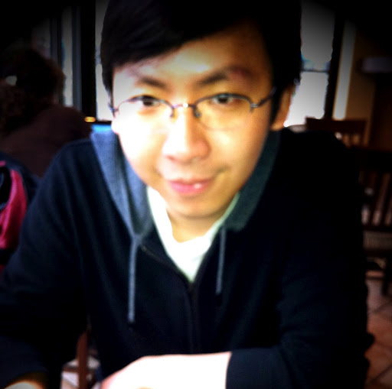
Timing
Current projects:
- "final reduction" of historic data
19 years of J1713+0747
Zhu et al. in preparation
IPTA Science Meeting 25 June 2012
Notes:
Add timing group talks!

Slide 20
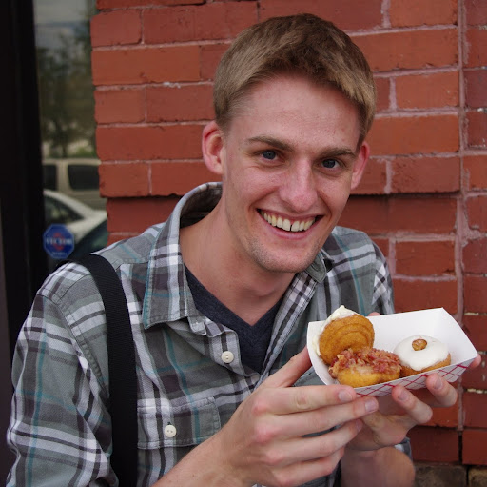
Timing
Current projects:
- "final reduction" of historic data
- reduction of WAPP data (non-coherent but wider band)
(See Joe Swiggum! Results look promising so far).
IPTA Science Meeting 25 June 2012
Notes:
EMAIL JOE RE: WAPP DATA!

Slide 21
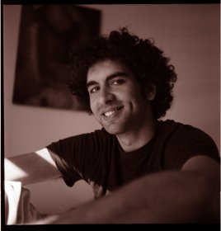
Timing
Current projects:
- "final reduction" of historic data
- reduction of WAPP data (non-coherent but wider band)
- full calibration of ASP/GASP data (Mueller matrices)
- polarization calibration of PUPPI/GUPPI data
- accounting for profile evolution with frequency
- measuring "local" DM as part of fit (UVA student Tim Pennucci!)
- measuring Shapiro delay for circular binaries
IPTA Science Meeting 25 June 2012

Slide 22
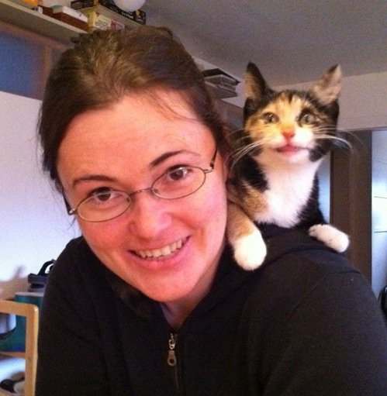
Noise Budgets
Identify components of variance and then associate them with astrophysical and instrumental causes.
White noise: Radiometer, Scintillation, Jitter
Red noise: Spin/torque, Orbital, Scattering
Non-white, non-red: Ephemerides, Instrumental polarization
See Jim Cordes’ talk and
Delphine Perrodin’s talk!
Shannon and Cordes 2010
IPTA Science Meeting 25 June 2012
Notes:
What’s correctable and what’s not? Orbital not. Scintillation yes. Scattering maybe. Delphine Perrodin will describe an cross-correlation method for characterizing timing noise.

Slide 23
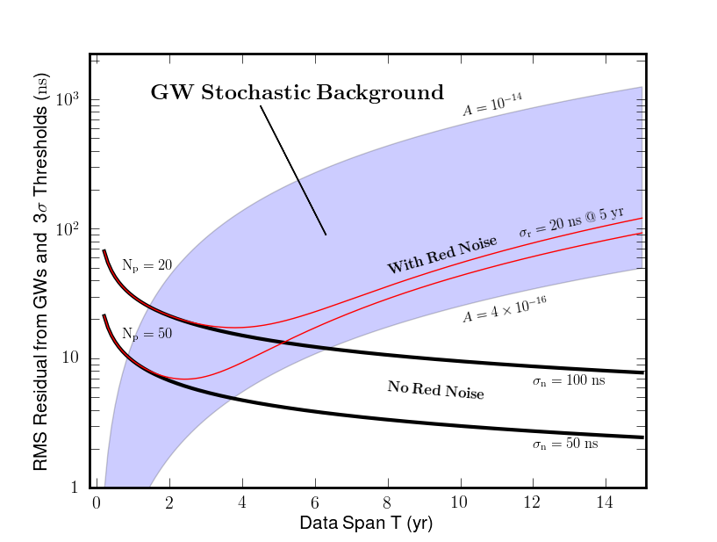
Noise Budgets
See Jim Cordes
IPTA Science Meeting 25 June 2012
Notes:
What’s correctable and what’s not? Orbital not. Scintillation yes. Scattering maybe. Delphine Perrodin will describe an cross-correlation method for characterizing timing noise.

Slide 24
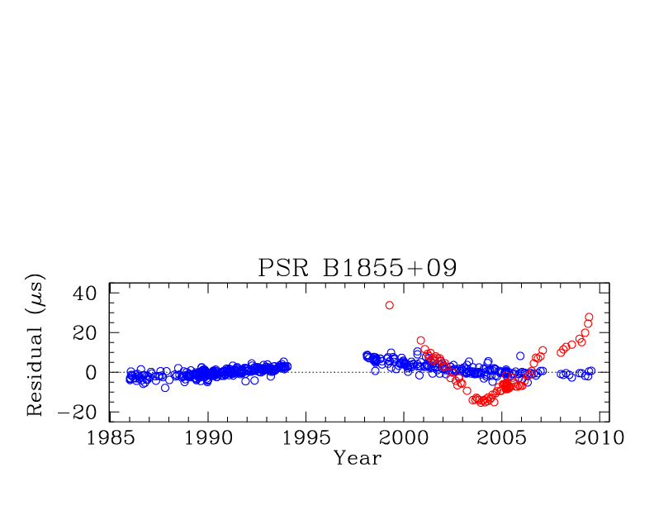
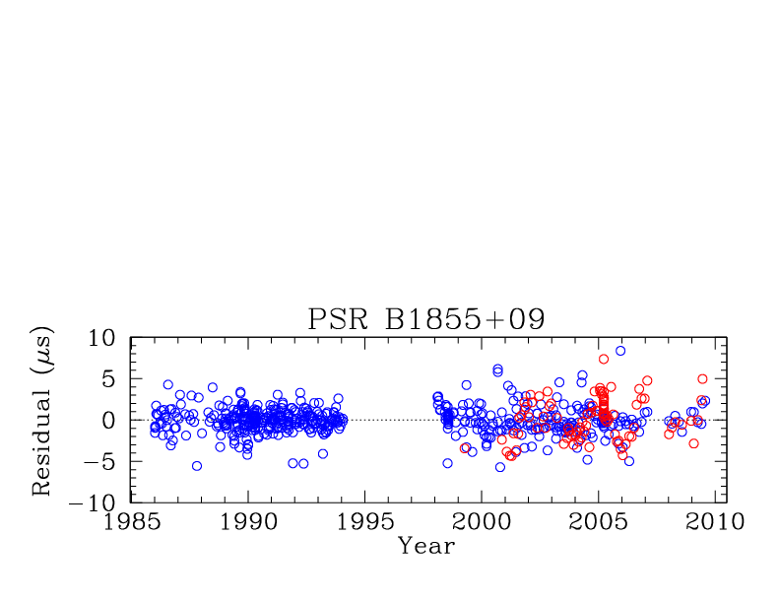
Interstellar Medium Mitigation
David Nice will discuss DM correction scheme for Demorest et al. 2012.
Exploring covariance
between DM determination
method and timing params.
See Tim Dolch’s talk!
D. Nice
1410 MHz
430 MHz
IPTA Science Meeting 25 June 2012
Notes:
One of the things we can correct for to some extent. We could greatly increase out timing precision on some pulsars if we could remove scattering delays.

Slide 25
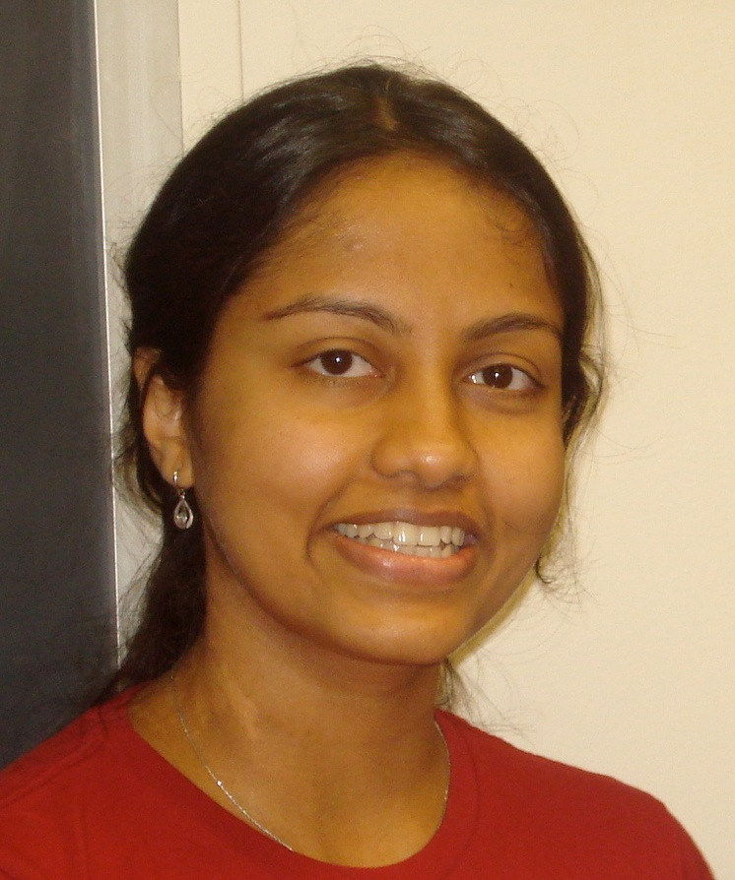
Interstellar Medium Mitigation
Experimenting with de-convolution methods to remove scattering delays.
Successful application of
cyclic spectroscopy (CS) to
B1937+21 data
(Demorest et al. 2011).
J1713 observed at AO to
test CS delay correction.
See Nipuni Palliyaguru’s
talk!
B1937+21 at 430 MHz
IPTA Science Meeting 25 June 2012
Notes:
Add year for Demorest! Deconvolution method to remove interstellar scattering delays. Cordes and Shannon paper.

Slide 26
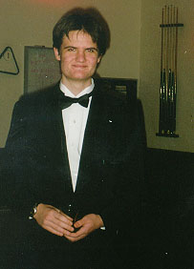
Interstellar Medium Mitigation
Experimenting with de-convolution methods to remove scattering delays.
Successful application of
cyclic spectroscopy (CS) to
B1937+21 data
(Demorest et al. 2011).
J1713 observed at AO to
test CS delay correction.
GPU-based CS!
See Glenn Jones’ talk!
B1937+21 at 430 MHz
IPTA Science Meeting 25 June 2012
Notes:
Add year for Demorest! Deconvolution method to remove interstellar scattering delays. Cordes and Shannon paper.

Slide 27
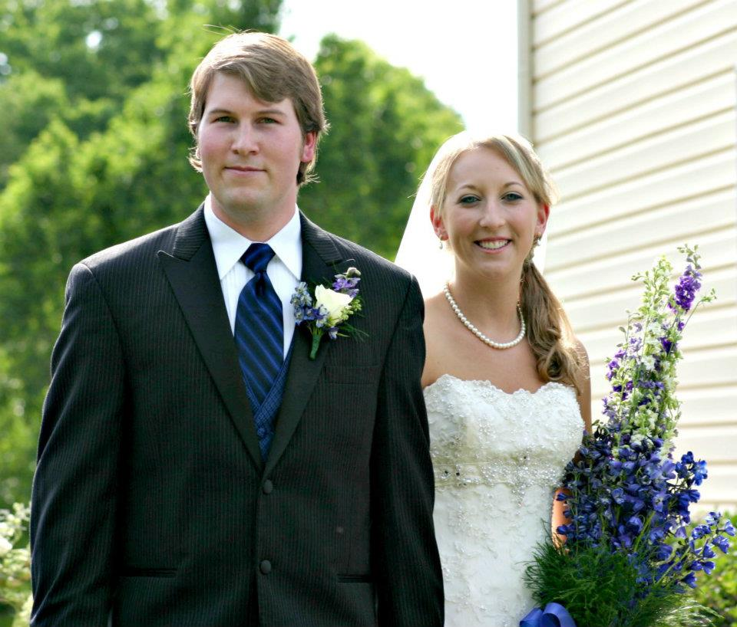
Detection
Recent Papers:
"Practical Methods for Continuous Gravitational Wave Detection," Ellis, Jenet, McLaughlin, accepted by ApJ.
IPTA Science Meeting 25 June 2012
Notes:
Plot shows the results for an Earth and Pulsar term matched filter and an Earth term only matches filter in source localization with a hypothetical PTA.

Slide 28
Detection
Recent Papers:
"Practical Methods for Continuous Gravitational Wave Detection," Ellis, Jenet, McLaughlin, accepted by ApJ.
"Optimal Strategies for Continuous Gravitational Wave Detection," Ellis, Siemens, Creighton, submitted to ApJ. See Justin’s talk!
"Maximum Likelihood estimation of timing noise parameters for NANOGrav pulsars," Ellis et al. in preparation.
"Searching for Periodic Gravitational Wave Sources with Pulsar Timing Arrays," Deng and Finn, in preparation.
IPTA Science Meeting 25 June 2012

Slide 29
Detection
Pipeline status:
Three independent continuous wave pipelines (time and frequency domain)
currently under development. One already deployed on IPTA and EPTA data.
See Justin Ellis’s talk and Yan Wang!
Developing New Stochastic Gravitational Wave Search Pipelines
See talk by Xavi Siemens!
Developing Burst Gravitational Wave Search Pipelines
Talk to Sam Finn and Andrea Lommen!
Running the first IPTA data challenge in collaboration with PPTA and EPTA.
NANOSoft repository located at:
https://sourceforge.net/projects/nanosoft/
IPTA Science Meeting 25 June 2012

Slide 30
Observing Optimization
Optimize observing frequencies, cadences, and MSP locations.
See talks by Andrea Lommen, Joe Simon, and Sam Finn!
Online simulators available at
and
Burt, Lommen, and Finn 2011
http://arcc.phys.utb.edu/nano_sandbox/
http://gwastro.psu.edu.
IPTA Science Meeting 25 June 2012

Slide 31
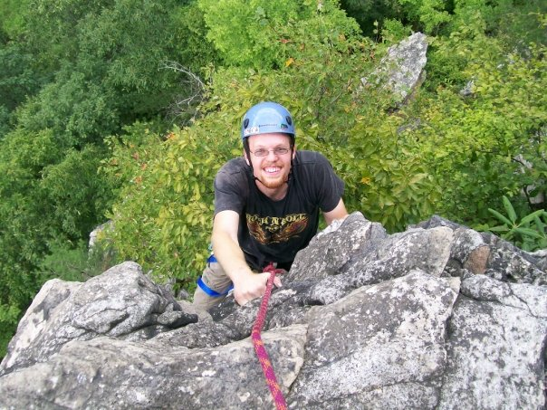
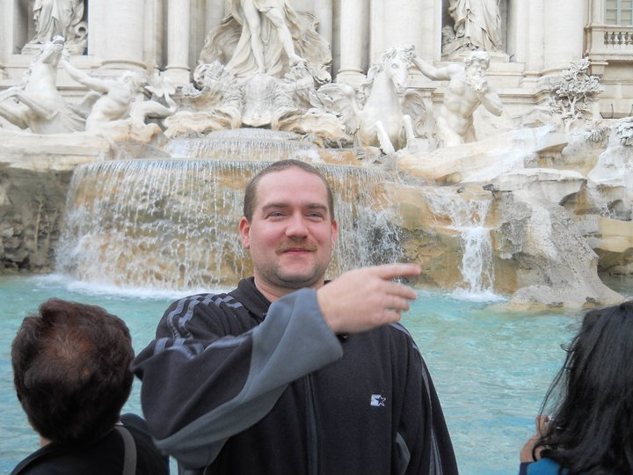
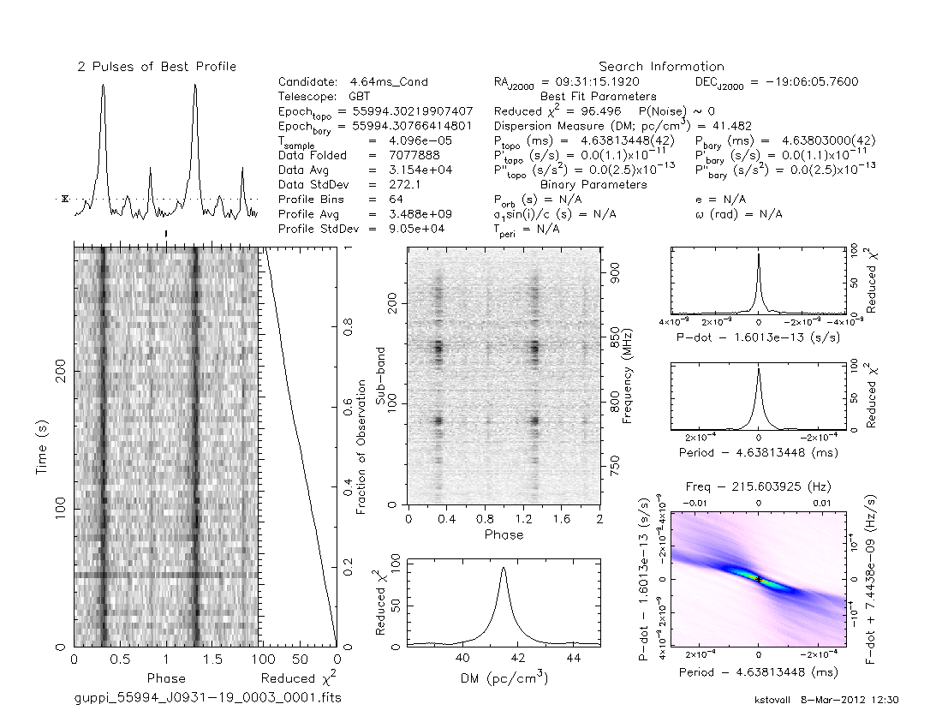
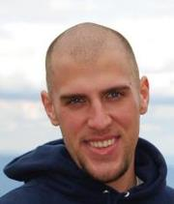
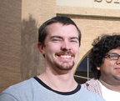
Searching
Still finding MSPs in PMPS (3! Mickaliger et al. in preparation)
12 MSPs in 350-MHz GBT surveys (Boyles et al.,
Lynch et al., and Stovall et al. in preparation)
Expect 50 MSPs by completion of all GBT sky survey!
See Ryan Lynch’s and Joe Swiggum’s talks!
K. Stovall
IPTA Science Meeting 25 June 2012
Notes:
Add year for Demorest! Deconvolution method to remove interstellar scattering delays. Cordes and Shannon paper.

Slide 32
Searching
Still finding MSPs in PMPS (3! Mickaliger et al. in preparation)
12 MSPs in 350-MHz GBT surveys (Boyles et al.,
Lynch et al., and Stovall et al. in preparation)
15 MSPs in 1400-MHz PALFA Survey (Deneva et al. submitted, Crawford et al. submitted).
Expect 50 MSPs by completion of PALFA!
See Duncan Lorimer’s talk!
Crawford et al. submitted
IPTA Science Meeting 25 June 2012
Notes:
Add year for Demorest! Deconvolution method to remove interstellar scattering delays. Cordes and Shannon paper.

Slide 33
International Education
IPTA Science Meeting 25 June 2012

Slide 34
International Education
PIRE is a $6.5M NSF grant to 9 U.S. institutions. The project has 5 goals:
Goal 1 Knowledge – Advance new knowledge and discoveries at the frontiers of science?
Goal 2 Education - Facilitate greater student and faculty preparation for and participation in international research collaboration ?
Goal 3 Partnerships - Enable U.S. scientists to establish collaborative relationships and operate effectively in teams comprised of partners from different nations and cultural backgrounds?
Goal 4 Institutional Capacity - Strengthen the capacity of institutions and networks to engage in and benefit from international research and education collaborations ?
Goal 5 Workforce Development - Develop a diverse, globally-engaged science workforce by catalyzing a higher level of international engagement by the U.S. science community?
IPTA Science Meeting 25 June 2012
Notes:
Note a grant to US colleagues

Slide 35
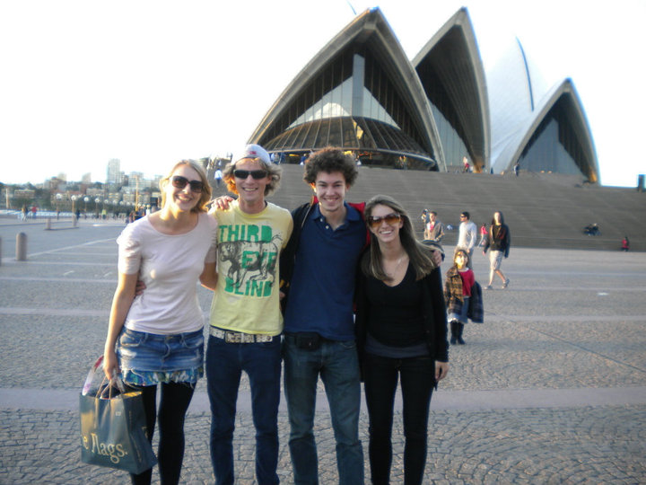
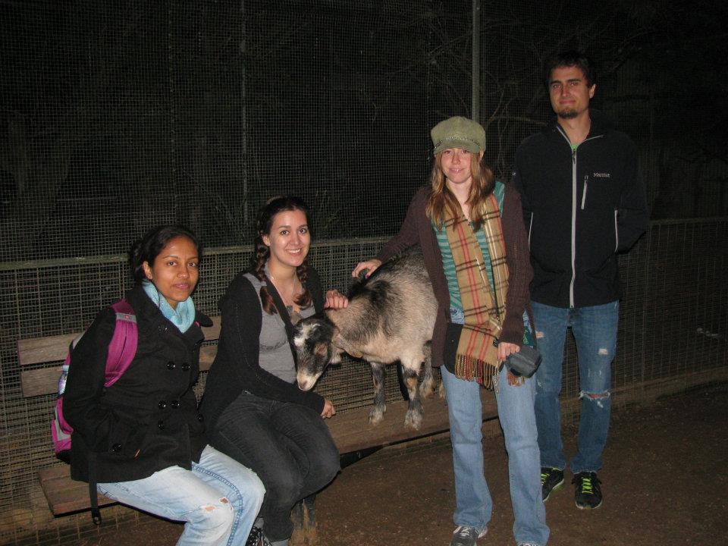
International Education
PIRE award supports workshops and meetings (like this one!) and also funds students to travel abroad for research and study.
Willie Kunert (Oberlin) @ ATNF In 2010
and Bonn in 2011.
Emma Handzo and Abi Polin (F&M) @ Manchester
in summer of 2011.
Mikaela Larkin (Oberlin) @ Tasmania now.
Joey Martinez (UTB) @ Bonn now.
David Day (UWM) @ Manchester now.
Gary Marchiny (WVU)@ Manchester for 2012-2013.
We also welcome foreign students visiting our institutions!
IPTA Science Meeting 25 June 2012

Slide 36
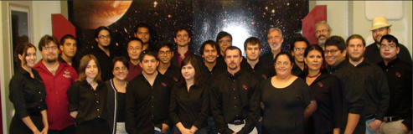
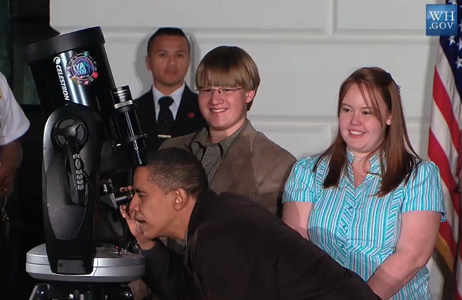
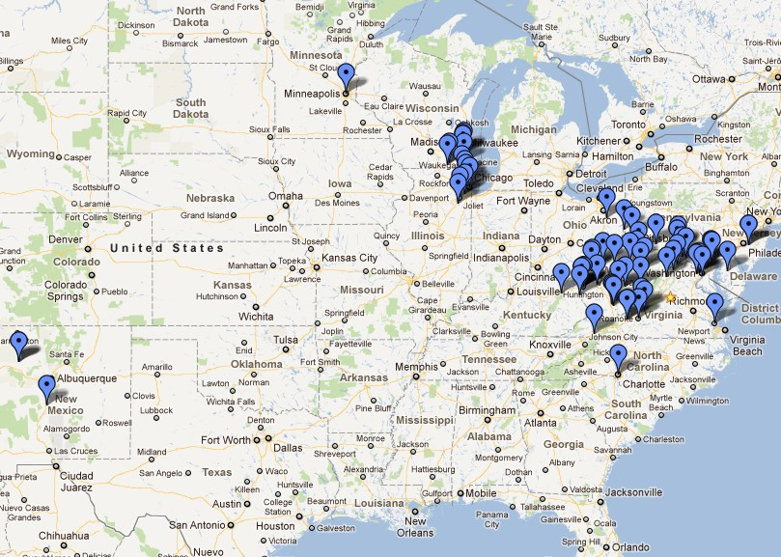
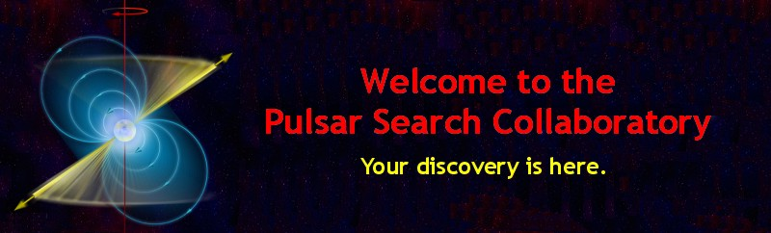
Outreach
MARIE (Mid-Atlantic Relativistic Initiative in Education) @
F&M - undergraduates teach in high schools (including
remote observations), and host open houses at F&M.
ARCC @ UTB and ARCC @ UWM involve high-school and undergraduate students in pulsar searching – 25 new pulsars in last 1.5 years!
PSC (NRAO and WVU) involves > 600 high-school
students throughout US in pulsar searching – 5 new
pulsars found, including one MSP.
See Joe Swiggum’s talk!
IPTA Science Meeting 25 June 2012

Slide 37
Summary of Successes
We have developed an infrastructure which will foster exchange of ideas, recognition of contributions of all members, student nurturing, and creativity.
We are forming partnerships with observatories.
Our first “NANOGrav” paper has been published and we have several other pipelines in the pipeline.
We are receiving more observing time than ever and hope to continue to see that increase even further.
We’ve received our first multi-institutional grant and aim for more such funding opportunities.
We are training many students for the international research climate.
IPTA Science Meeting 25 June 2012
Notes:
MORE PULSARS! Pulsar sharing – how to assess?

Slide 38
The Future
Funding for Arecibo and the GBT is not guaranteed and the NSF Portfolio Review may dramatically affect the operation of these telescopes.
We are advocating for new L+S-band receivers on both GBT and Arecibo.
We are working to determine the optimal observing plans for each telescope.
What are the ultimate limits of our sensitivity?
What do our source classes really look like?
How much data should we store and how much storage capacity do we need?
How can we work with other institutions to connect our outreach and education efforts?
How can we work with other telescopes such as FAST and MeerKAT and eventually SKA (See Scott’s Talk!)? Coordinated IPTA effort!!
IPTA Science Meeting 25 June 2012
Notes:
MORE PULSARS! Pulsar sharing – how to assess?

